Slide 1
map final updated
File created on: 8/6/2021 12:06:38 AM

Slide 2
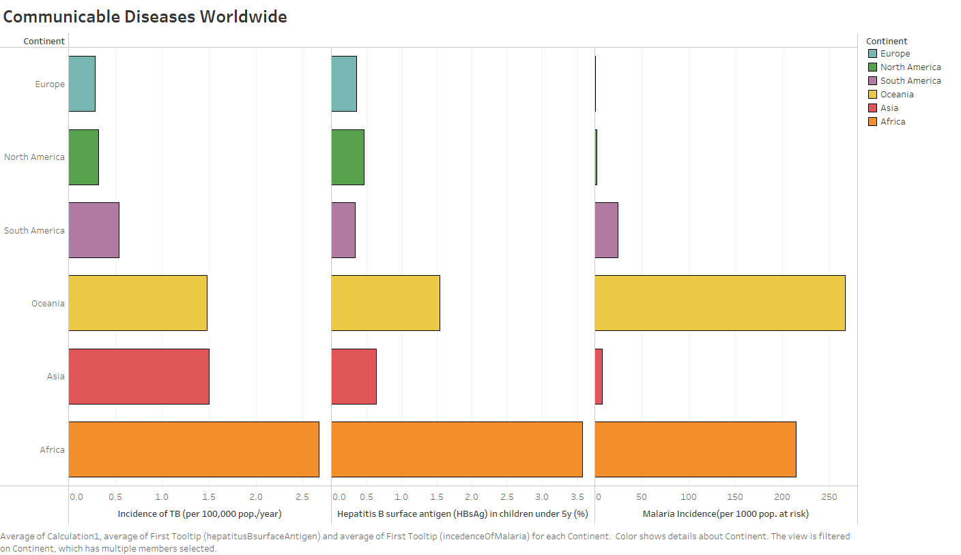

Slide 3
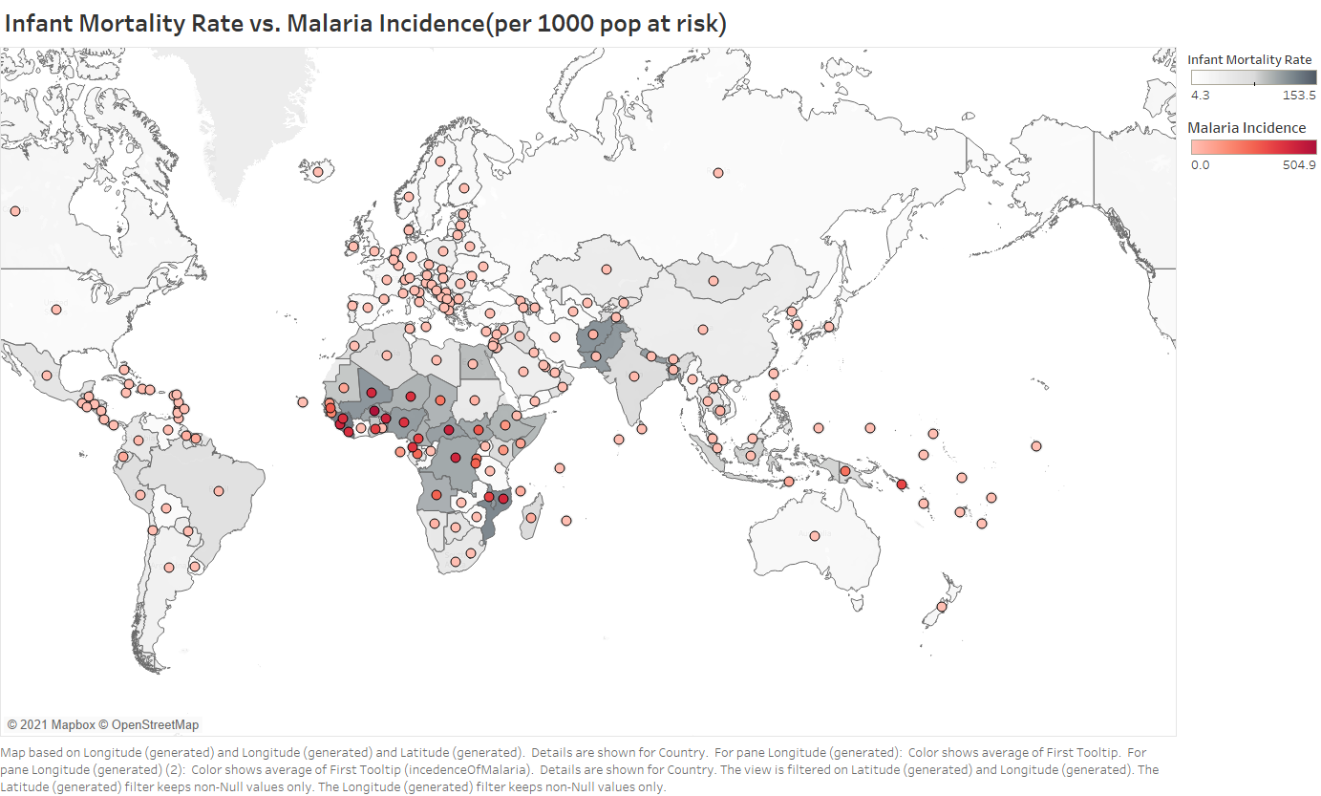

Slide 4
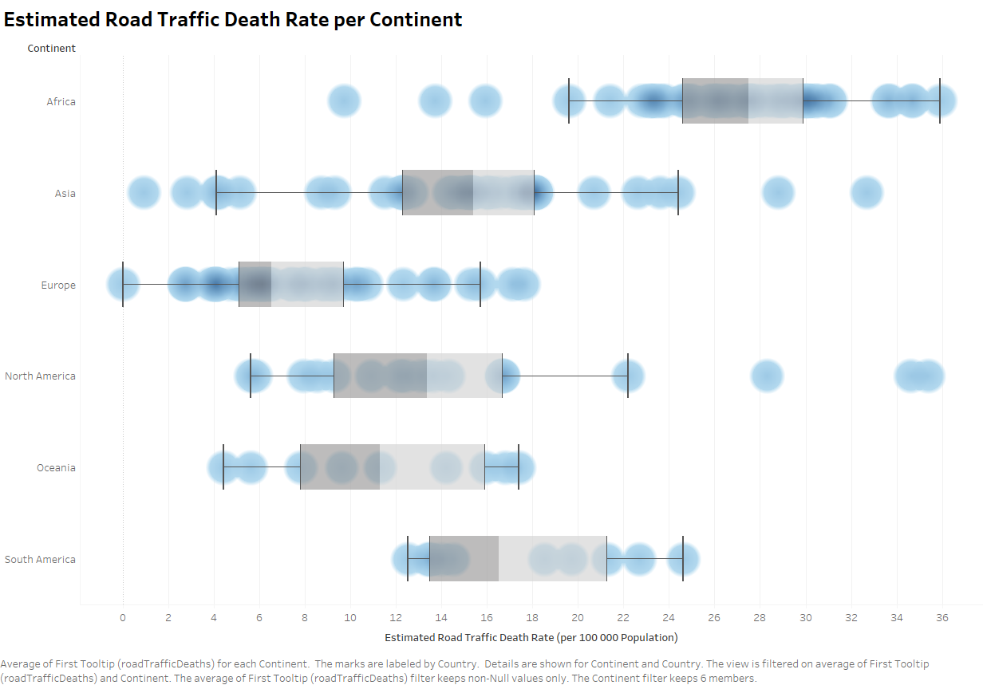

Slide 5
